Slide 1
Dissipation, Speed, and Accuracy in Early T-cell Recognition
Wenping Cui
Dissertation Advisor: Prof. Pankaj Mehta
Committee Members: Prof. Ziqiang Wang, Prof. Kevin Bedell
Notes:
1

Slide 2
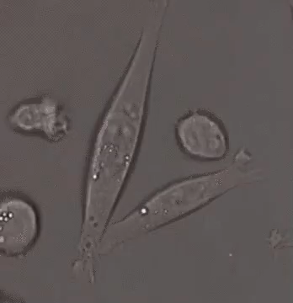
2
Backgournd
The immune system destroys disease-causing organisms.
Dr. Misty Jenkins, Walter and Eliza Hall Institute
Notes:
2

Slide 3
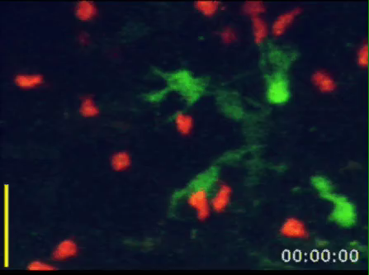
Backgournd
T cells are key effectors in the early immune response.
T cells are key effectors in the early immune response.
Red: T Cells Green: Dendritic Cells
Miller, Mark J., et al. The Journal of experimental medicine 200.7 (2004): 847-856.

Slide 4


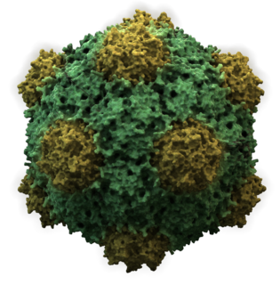
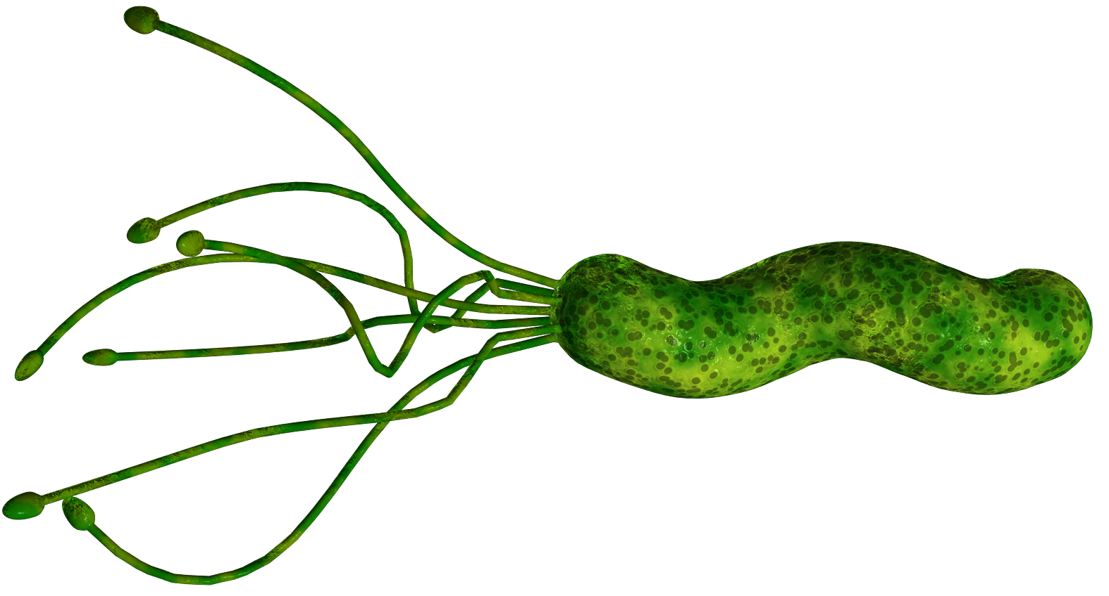
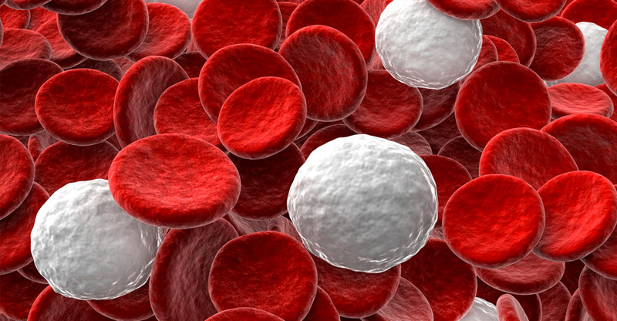

4
Self and Foreign Ligand
From Virus, Bacteria, Cancer cells…
From Our organisms
Notes:
4

Slide 5

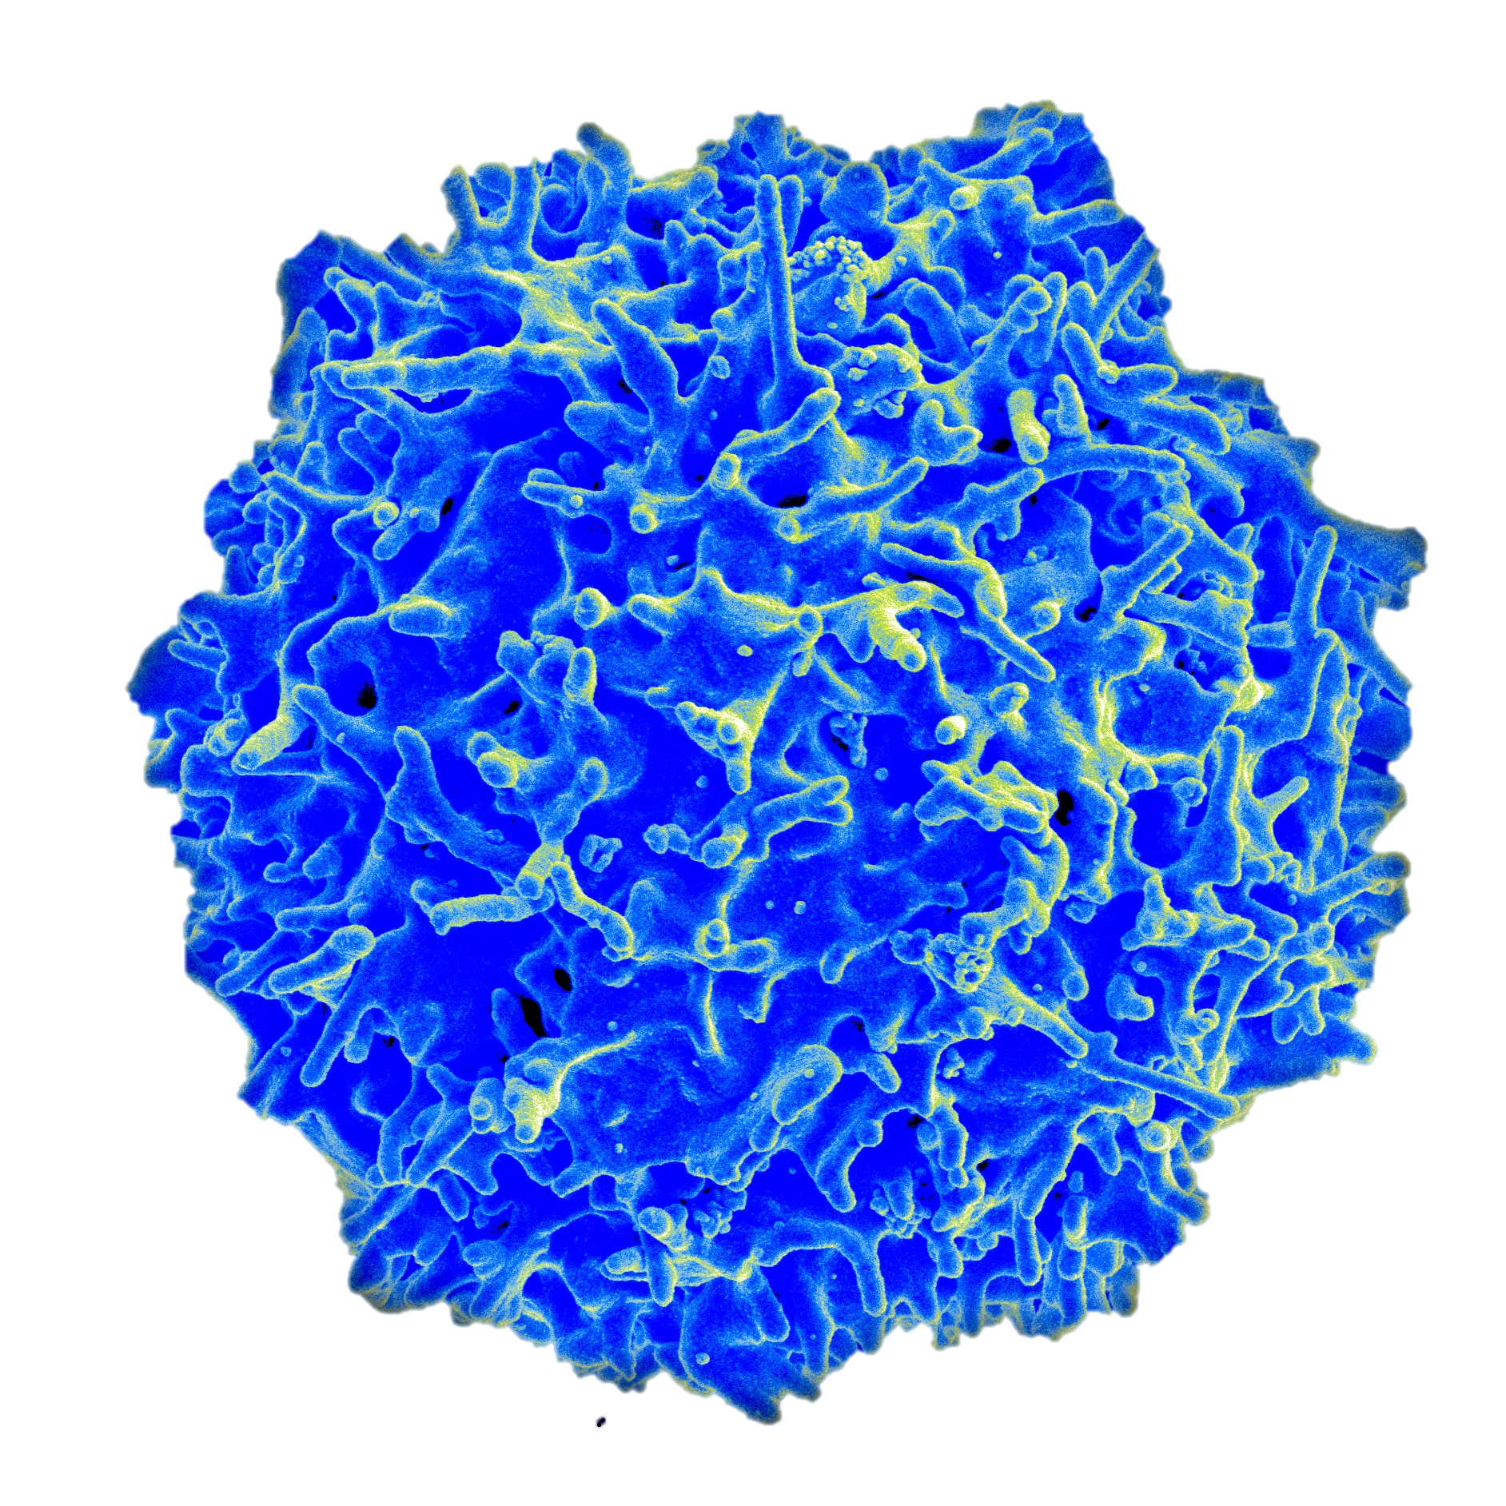
5
T Cells
Wiki:T-Cell
BY Bret Syfert, Big Picture
Notes:
5

Slide 6
6
Outline
Introduction
Receptor-ligand binding
Self-foreign discrimination
Dissipation, Speed and Accuracy
Power dissipation Mean First passage time(FPT) and speed
Trade-off
Kinetic Proofreading
Reversible rate
Optimal point
Adaptive Sorting
Future Plan
Notes:
6

Slide 7
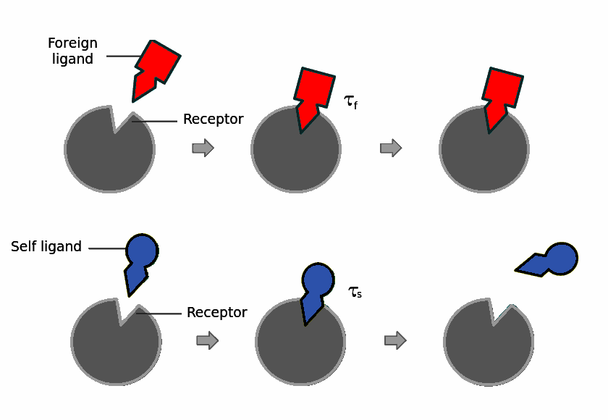

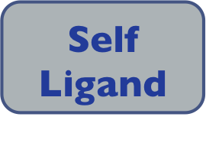
7
Receptor-ligand binding
Activated
Inactivate
Notes:
7

Slide 8
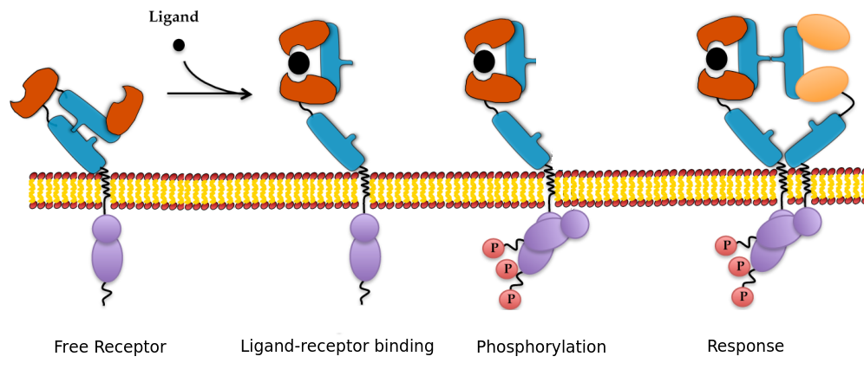
8
Receptor-ligand binding
Only difference is the binding time
The same rate for all kinds of ligands
P
P
P
P
P
P
P
P
P
P
P
P
P
P
P
P
P
P
P
P
Free Receptor
Receptor-ligand binding
1st phosphorylation
2nd phosphorylation
3rd phosphorylation
Activation
The same rate for all kinds of ligands
Notes:
8

Slide 9
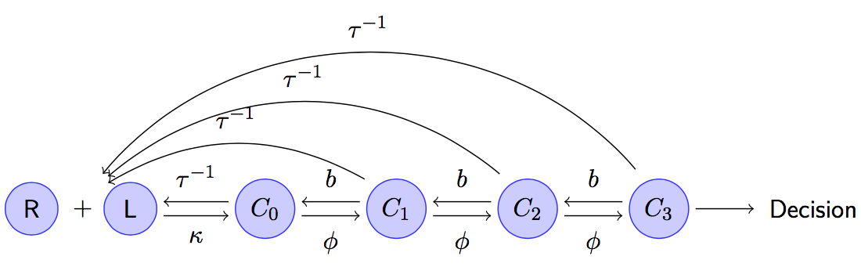
9
Model
P
P
P
P
P
P
P
P
P
P
P
P
P
P
P
P
P
P
Free Receptor
Receptor-ligand binding
1st phosphorylation
2nd phosphorylation
3rd phosphorylation
Activation
Notes:
9

Slide 10
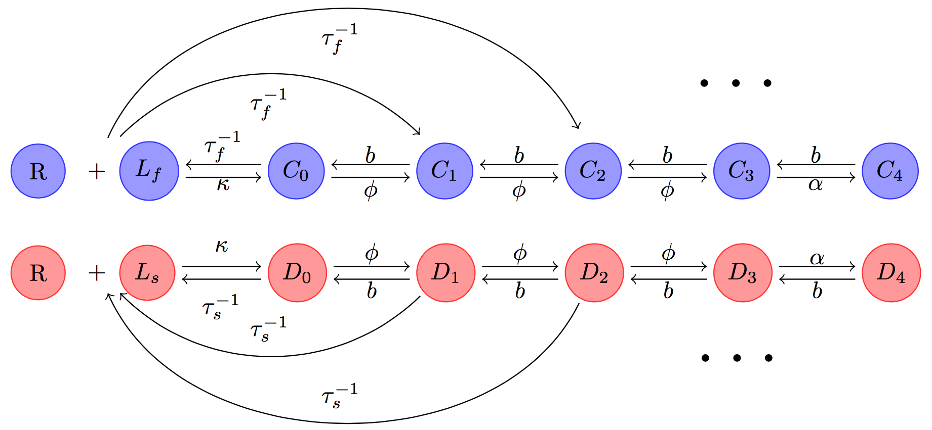
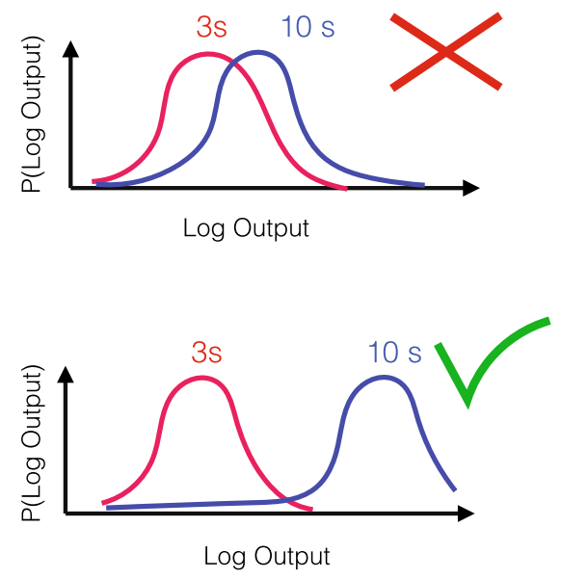
10
Discrimination
Poisson distribution
Output

Slide 11
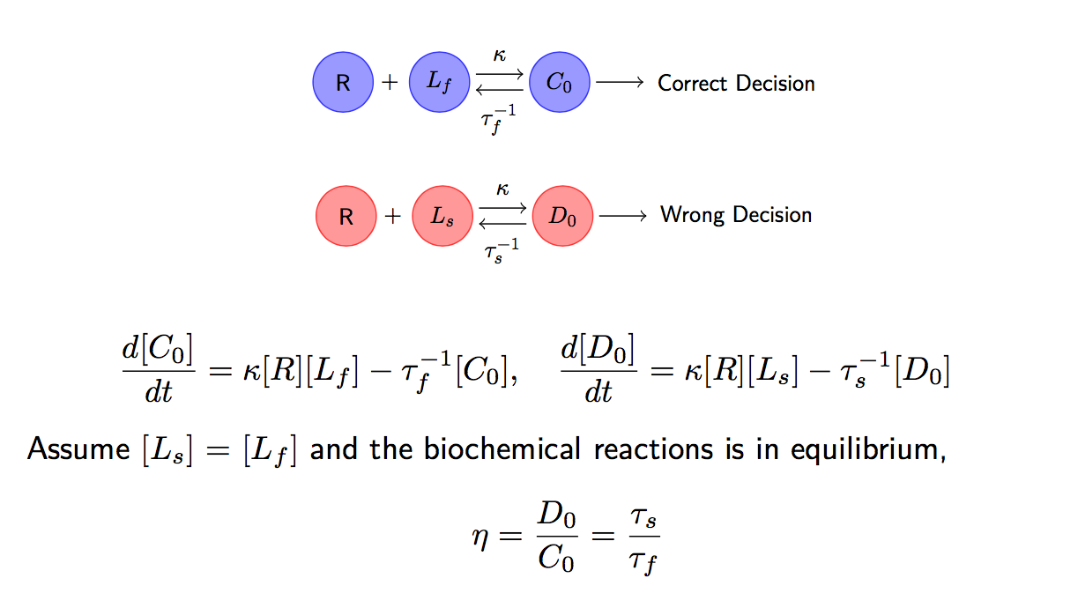
11
A simple model

Slide 12
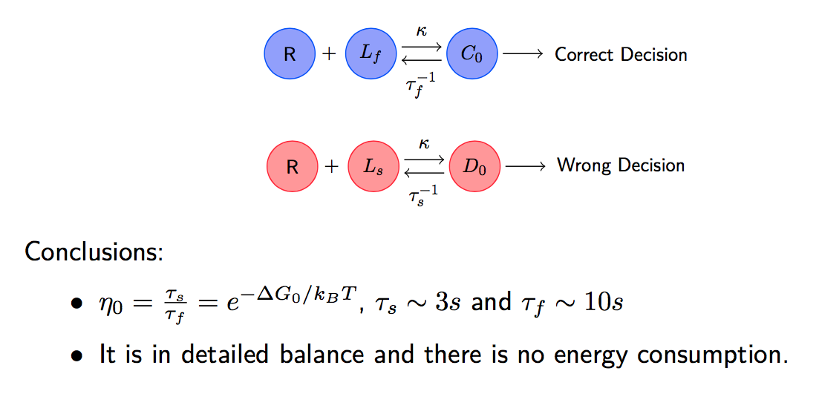
12
A simple model
The error rate is too large, compared with typical value 10⁻⁴ - 10⁻⁶ in T cells.

Slide 13
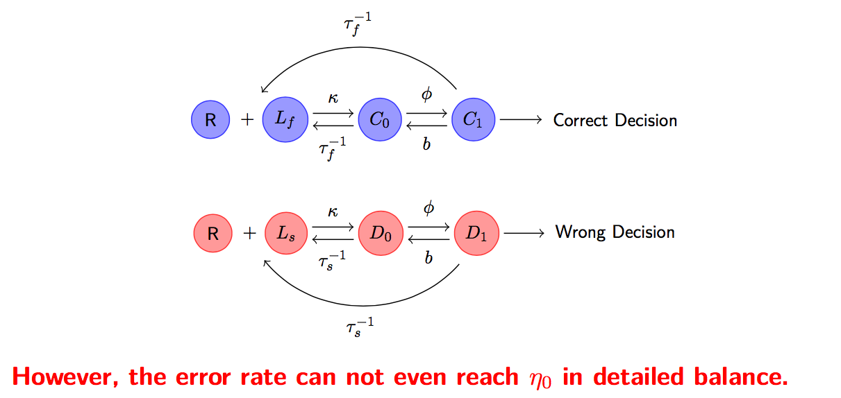
13
A natural idea is to increase the number of steps

Slide 14
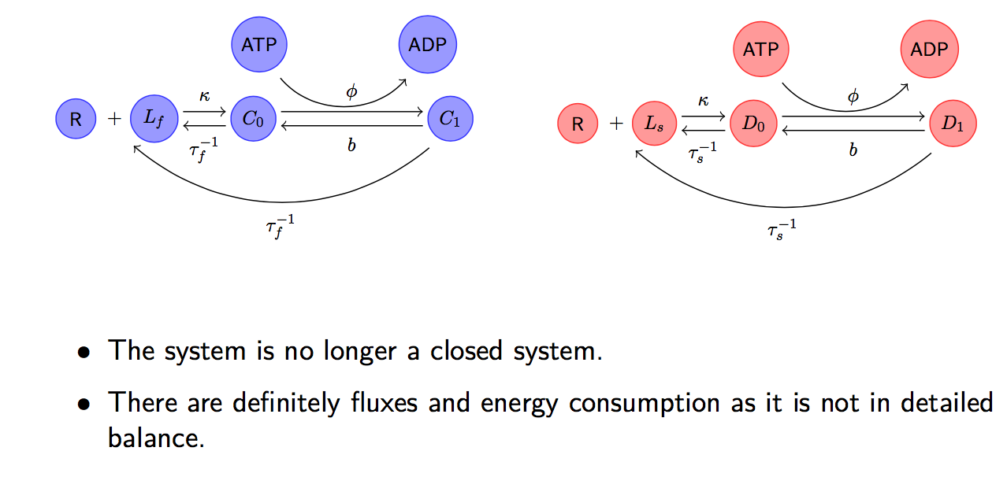
14
Kinetic Proofreading
The system is no longer in detailed balance resulting energy consumption.
Notes:
The SECOND SENTECE

Slide 15
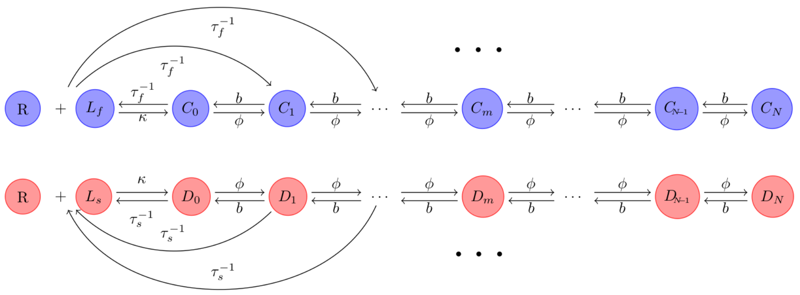
15
Kinetic Proofreading
ATP
ADP
ATP
ADP
ATP
ADP
ATP
ADP
ATP
ADP
ATP
ADP
Hopfield limit:

Slide 16
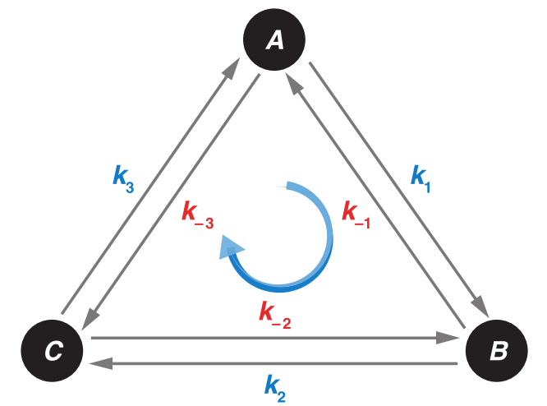
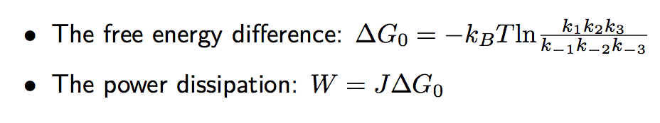
16
Power Dissipation
It not in detailed balance. There is a net flux due to energy consumption
ATP
ADP
Entropy production rate of Markov chain

Slide 17
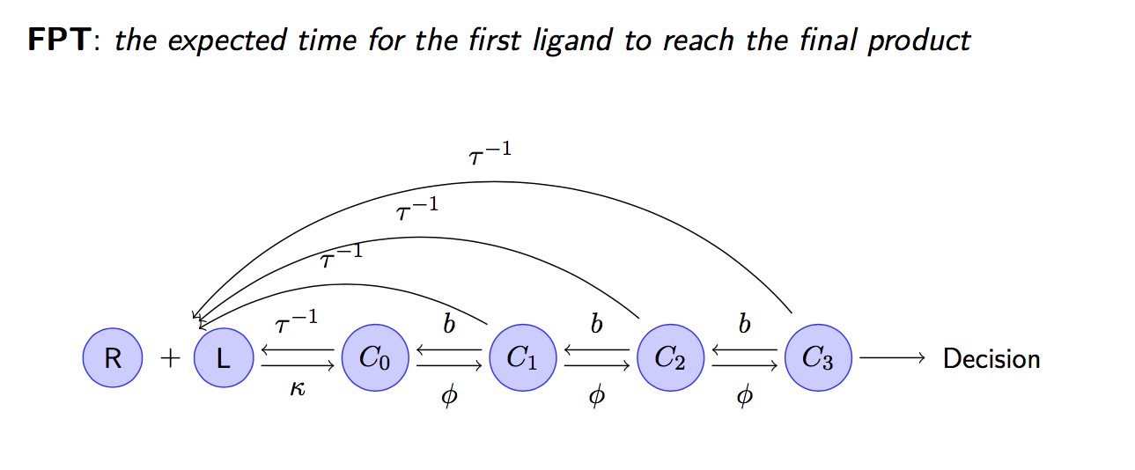
17
Mean First Passage Time(FPT) and Speed

Slide 18
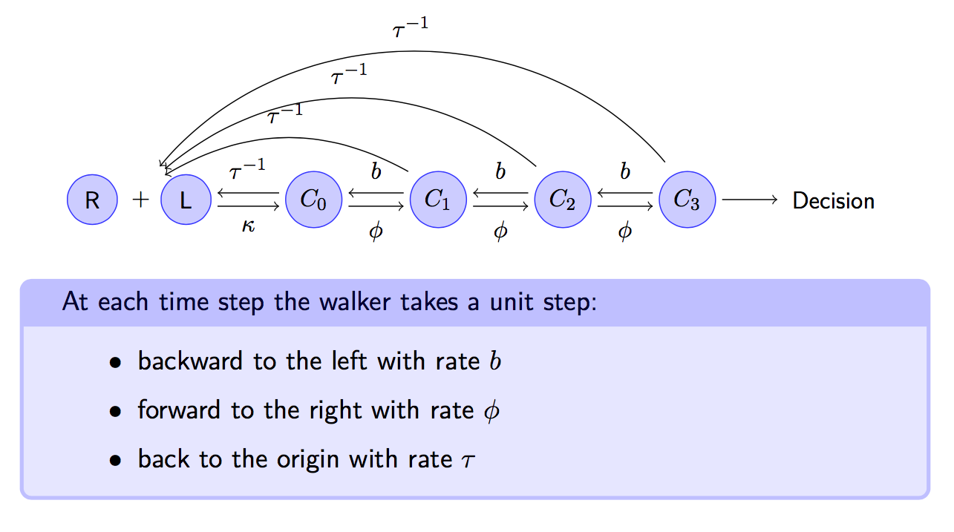
18
Mean First Passage Time(FPT) and Speed

Slide 19
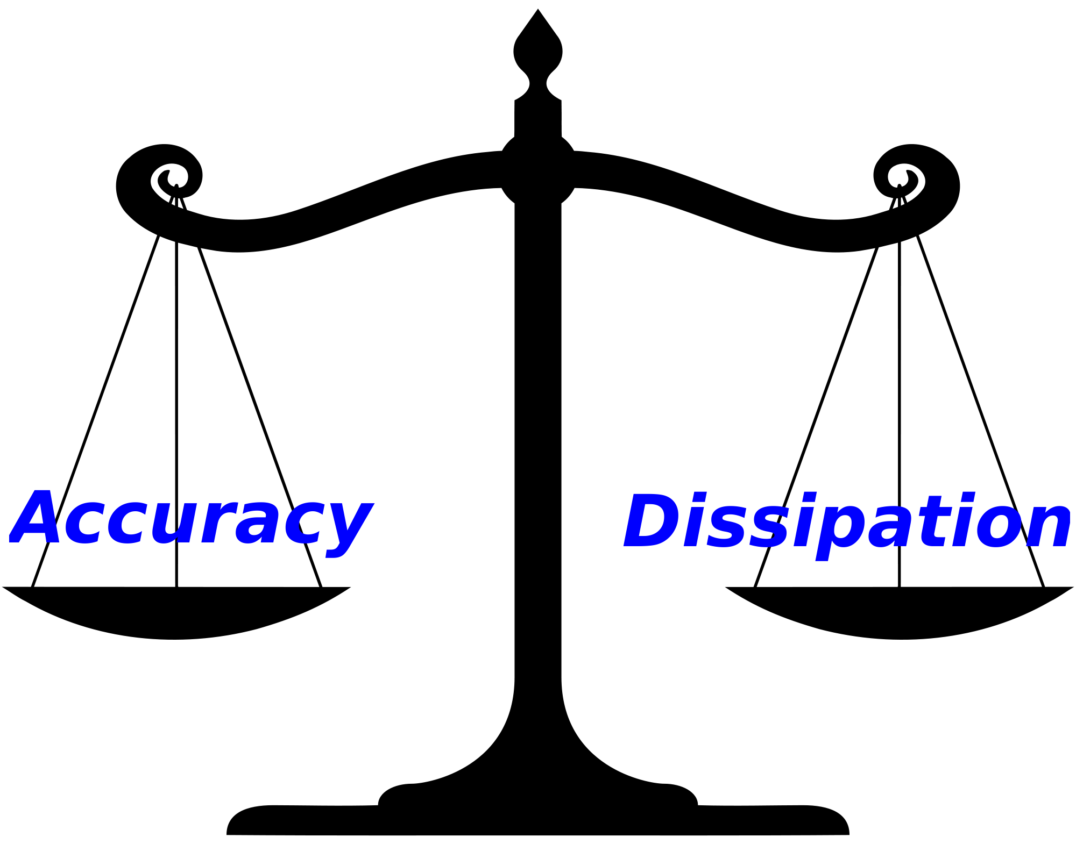
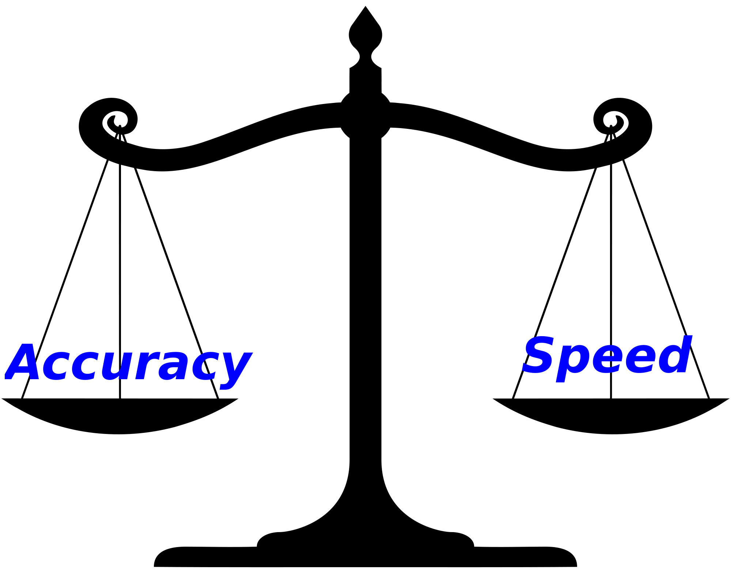
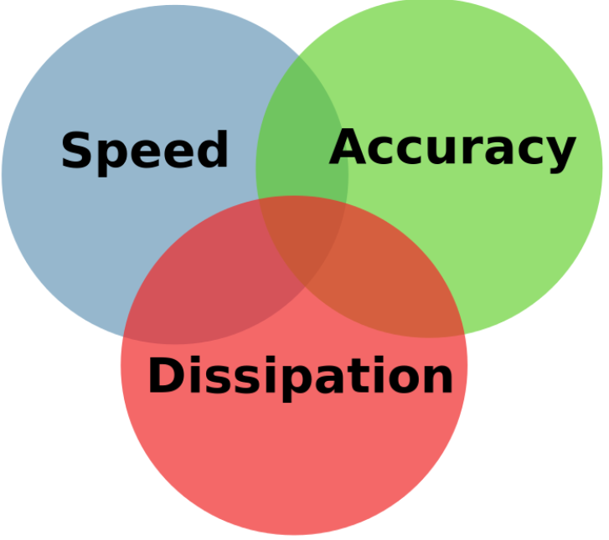
19
Trade Off

Slide 20
20
Kinetic Proofreading
Irreversible approximation makes it impossible to calculate the dissipation!

Slide 21
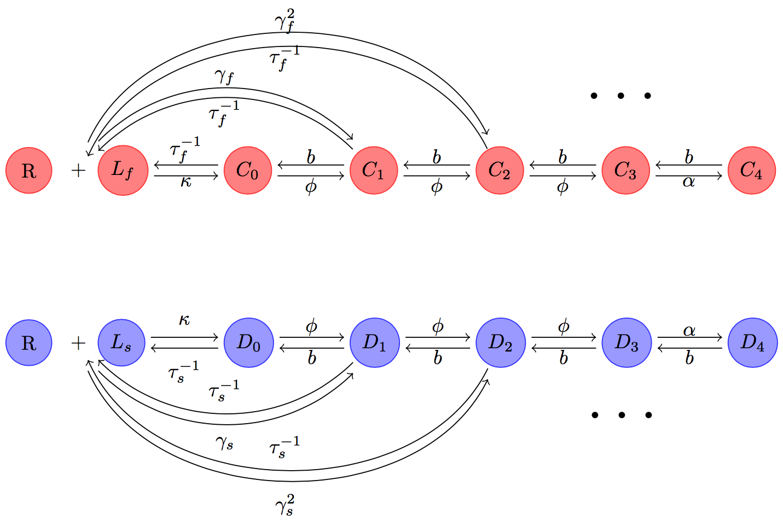
21
Reversible rate

Slide 22
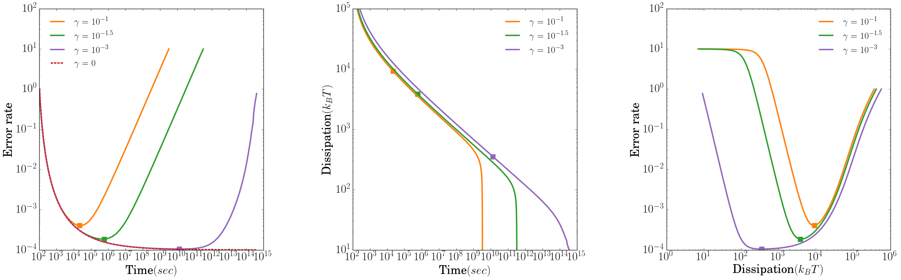
22
Reversible rate imply an optimal point!

Slide 23
23
a.
b.

Slide 24
24

Slide 25
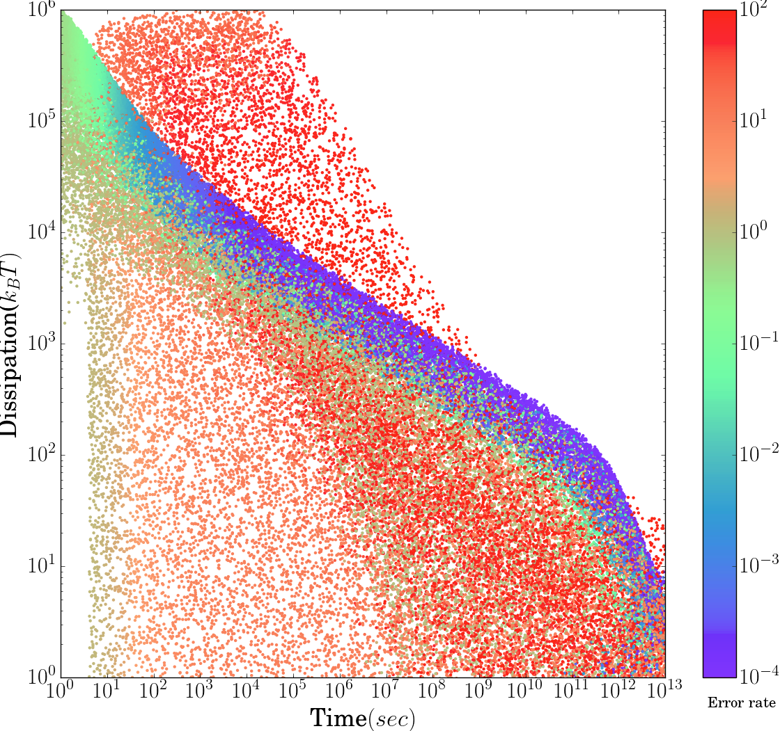
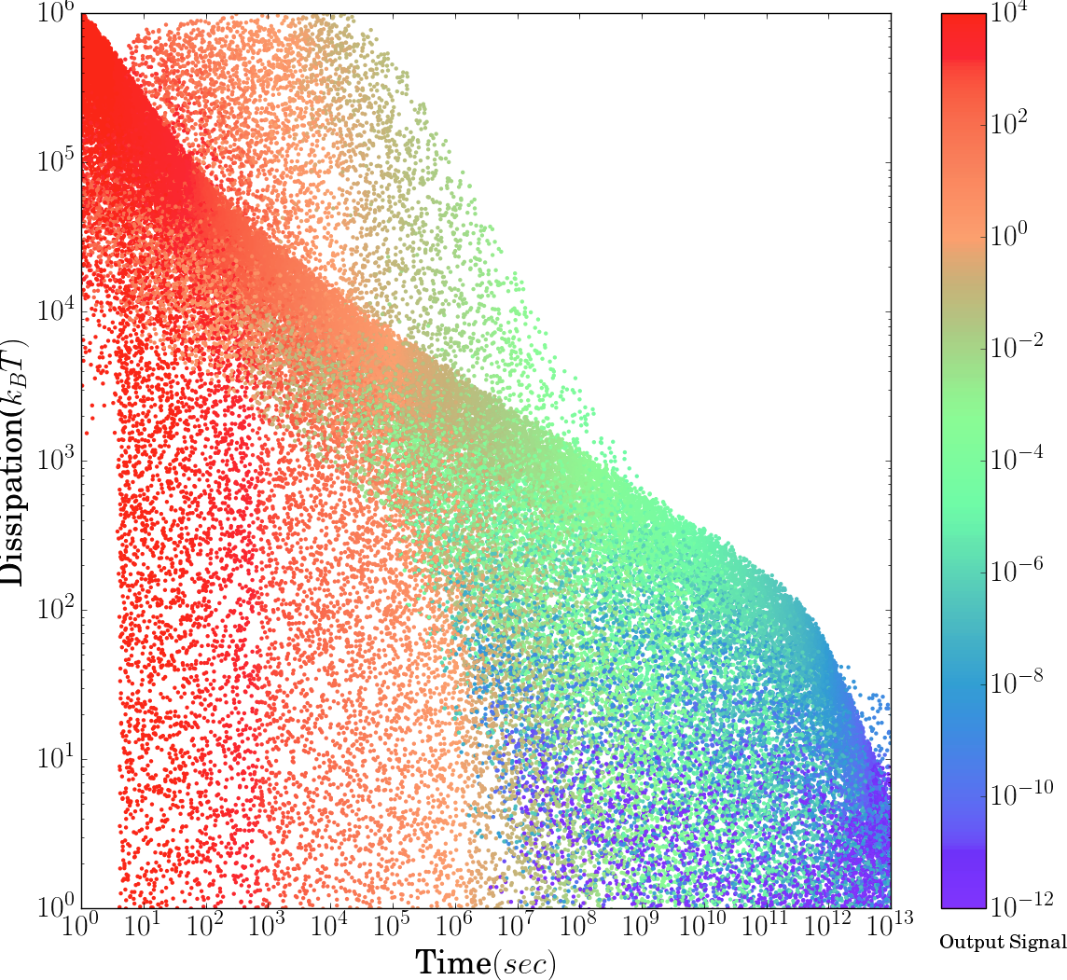
25
Optimal Point
Error rate
Output Signal:

Slide 26
26
Optimal Point
Optimal point
Error rate
Output Signal:

Slide 27
27
Comparison
Optimal Point
Experiment
Time: 100 seconds 1-5 mins
Error rate: 10⁻³ 10⁻⁴-10⁻⁶
Dissipation: 10⁴ ATP/s 10⁹ ATP/s in the whole cell

Slide 28
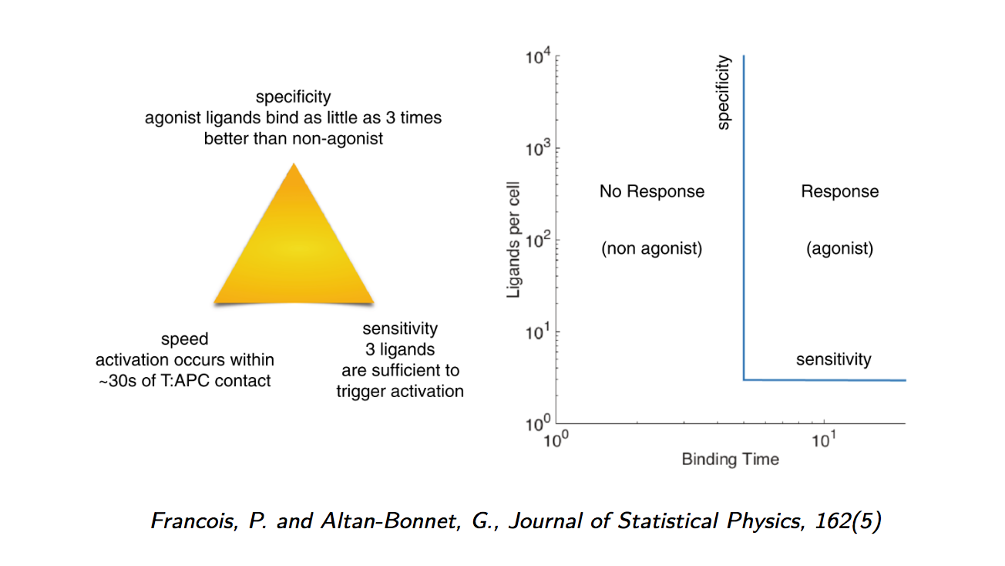

28
Adaptive Sorting
In fact

Slide 29
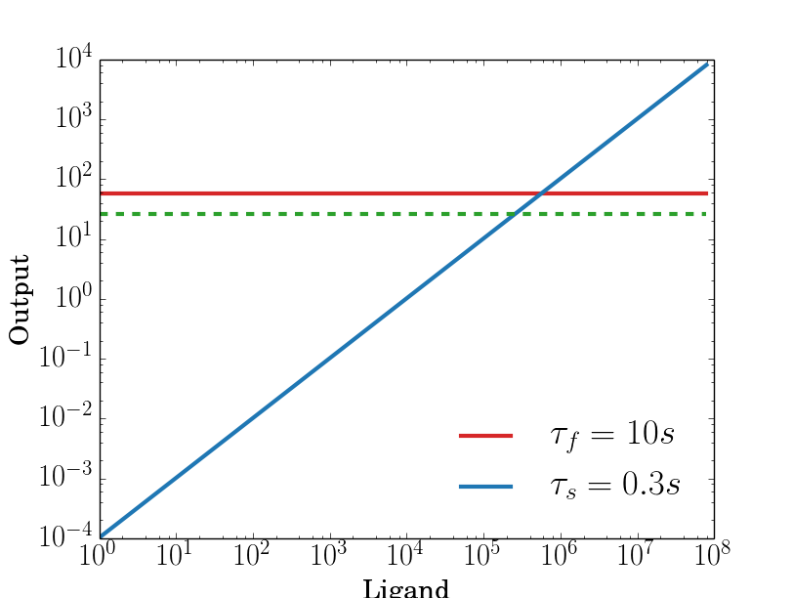
29
Kinetic proofreading when

Slide 30
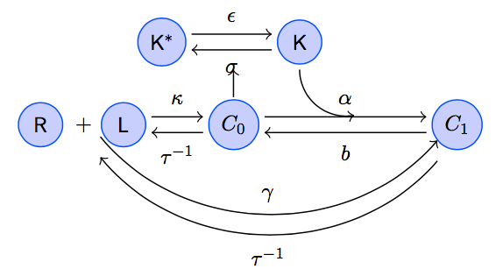
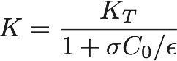
30
Adaptive Sorting
Inactive Kinase
Active Kinase
The proof reading process is modulated by regulation of the phosphorylation rate αK from C₀ to C₁.

Slide 31
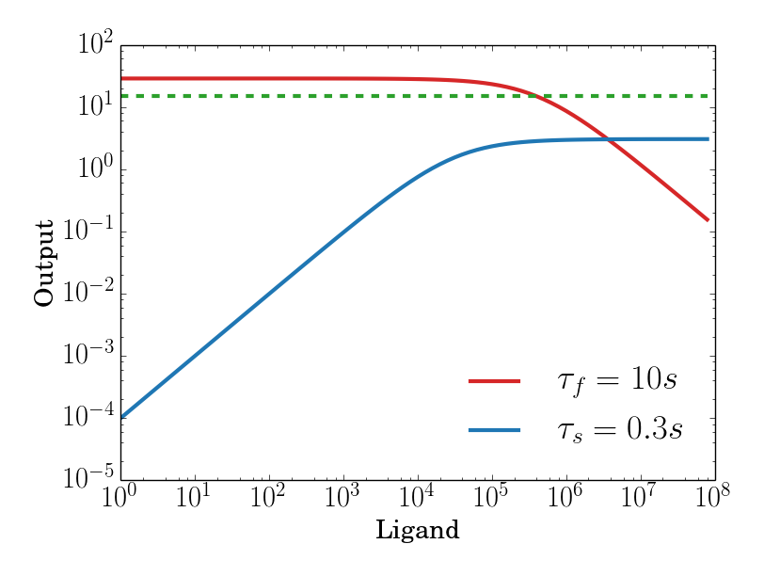
31
Adaptive Sorting
Kinetic Proofreading
Adaptive Sorting

Slide 32
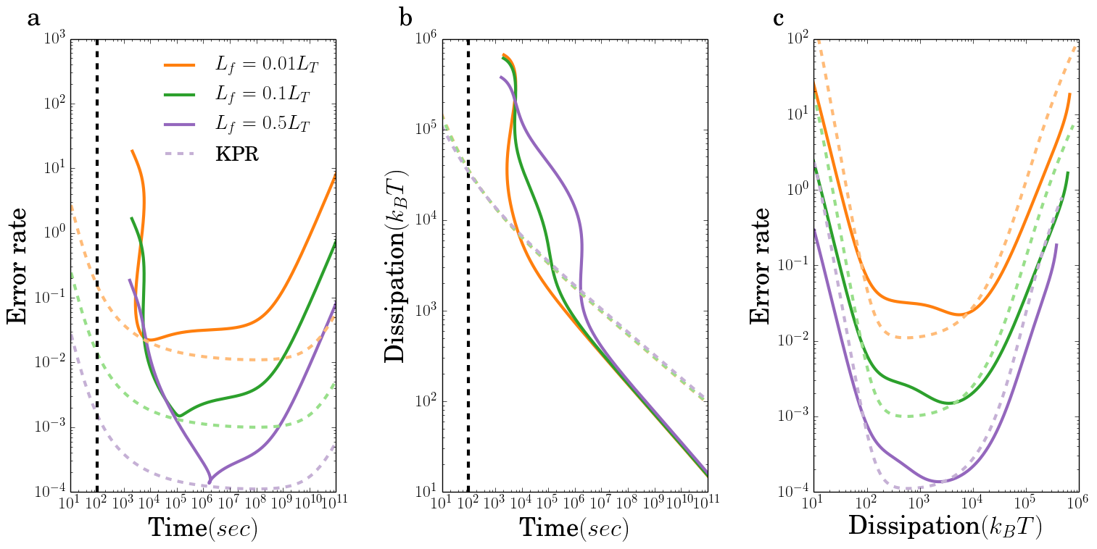
32
Adaptive Sorting
Adaptive Sorting will reduce the speed!

Slide 33
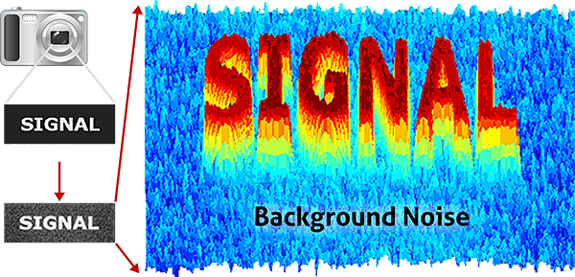
33
Future Plan: beyond kinetic proofreading
Self-ligand signal as background noise

Slide 34
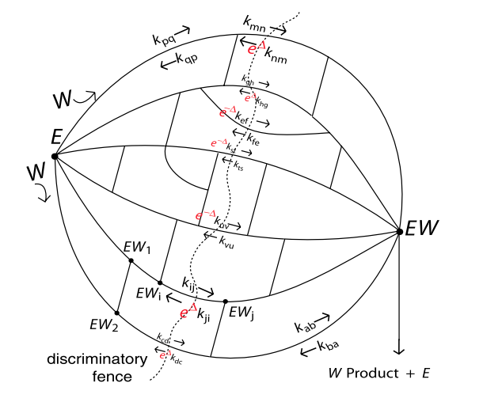
34
Future Plan: general network
Murugan, A., Huse, D. A., & Leibler, S. Physical Review X, 4(2), 021016.

Slide 35
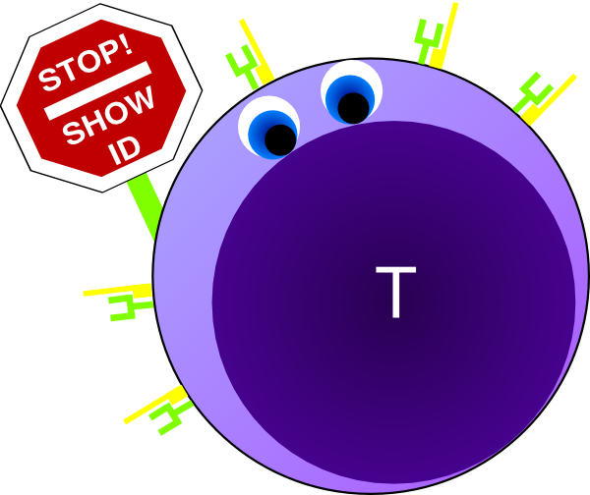
35
Thank you for your attention!

Slide 36
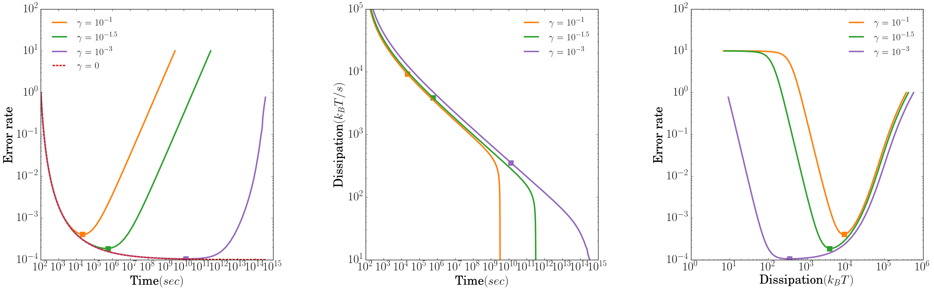
36
a.
b.

Slide 37
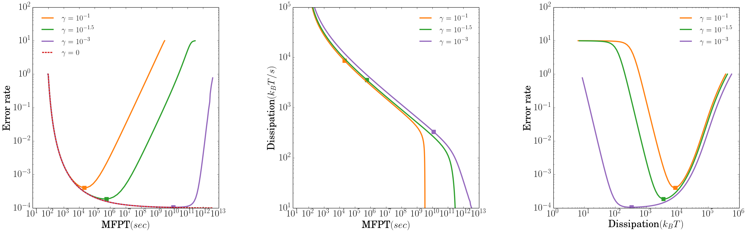
37
a.
b.

Slide 38
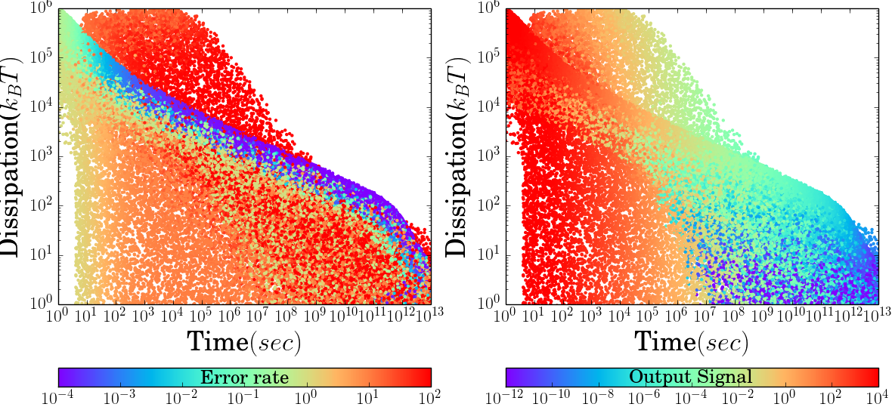
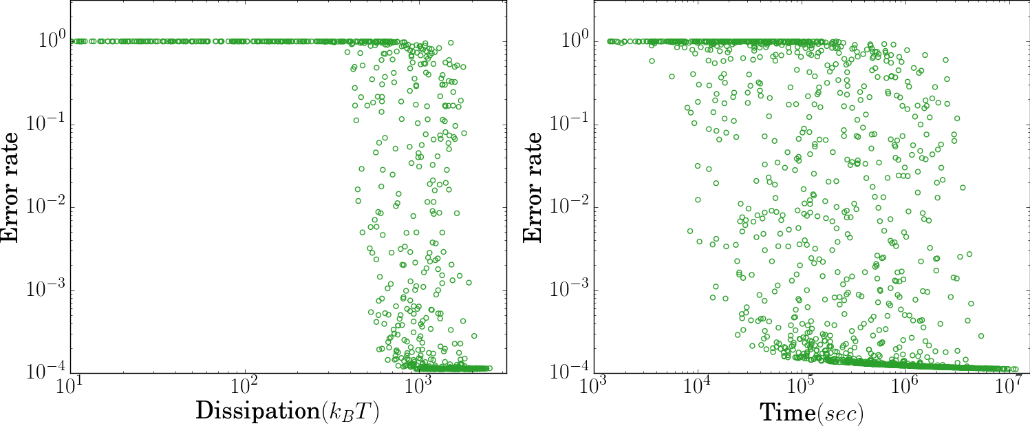
38
a.
b.
Optimal Point
c.
d.

Slide 39
39
a.
b.
Optimal Point
C
A
B
D
B
c.
d.

Slide 40
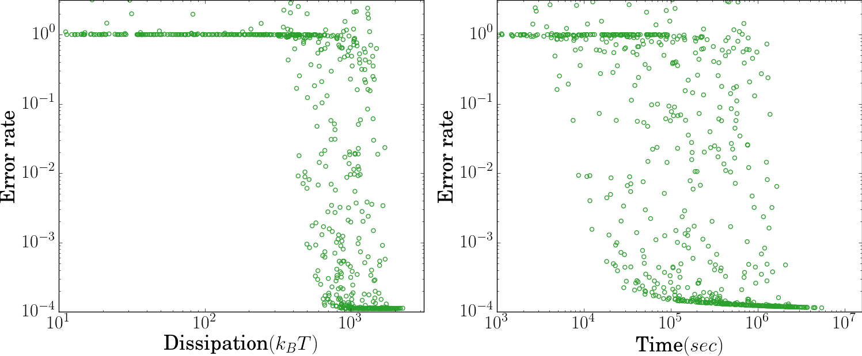
40
a.
b.
Optimal Point
C
A
B
D
B
c.
d.

Slide 41
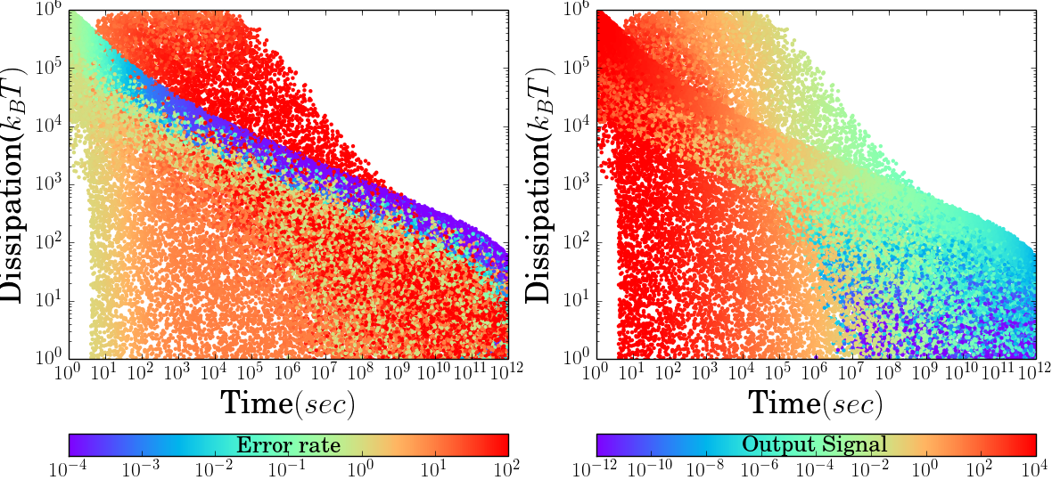
41
a.
b.
Optimal Point
C
A
B
D
B
c.
d.

Slide 42
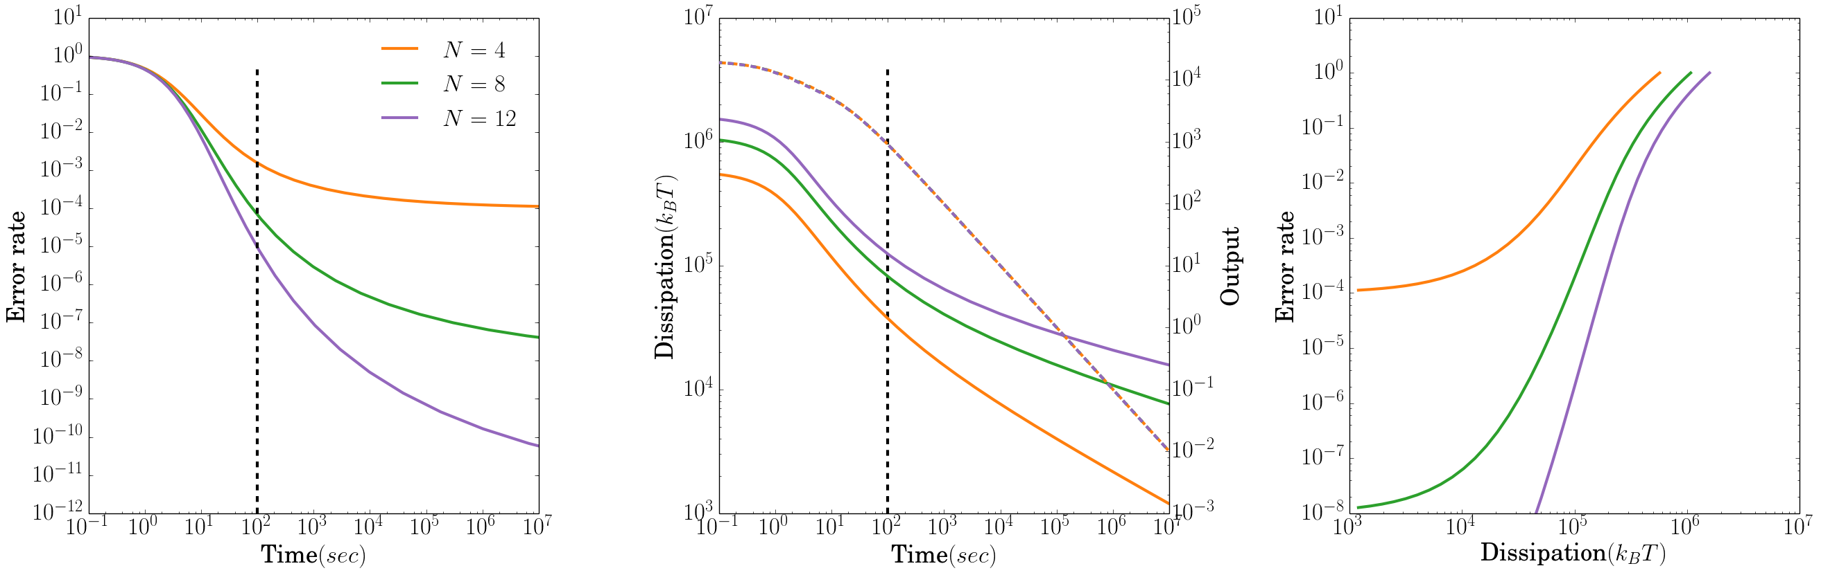
42
a.
b.

Slide 43
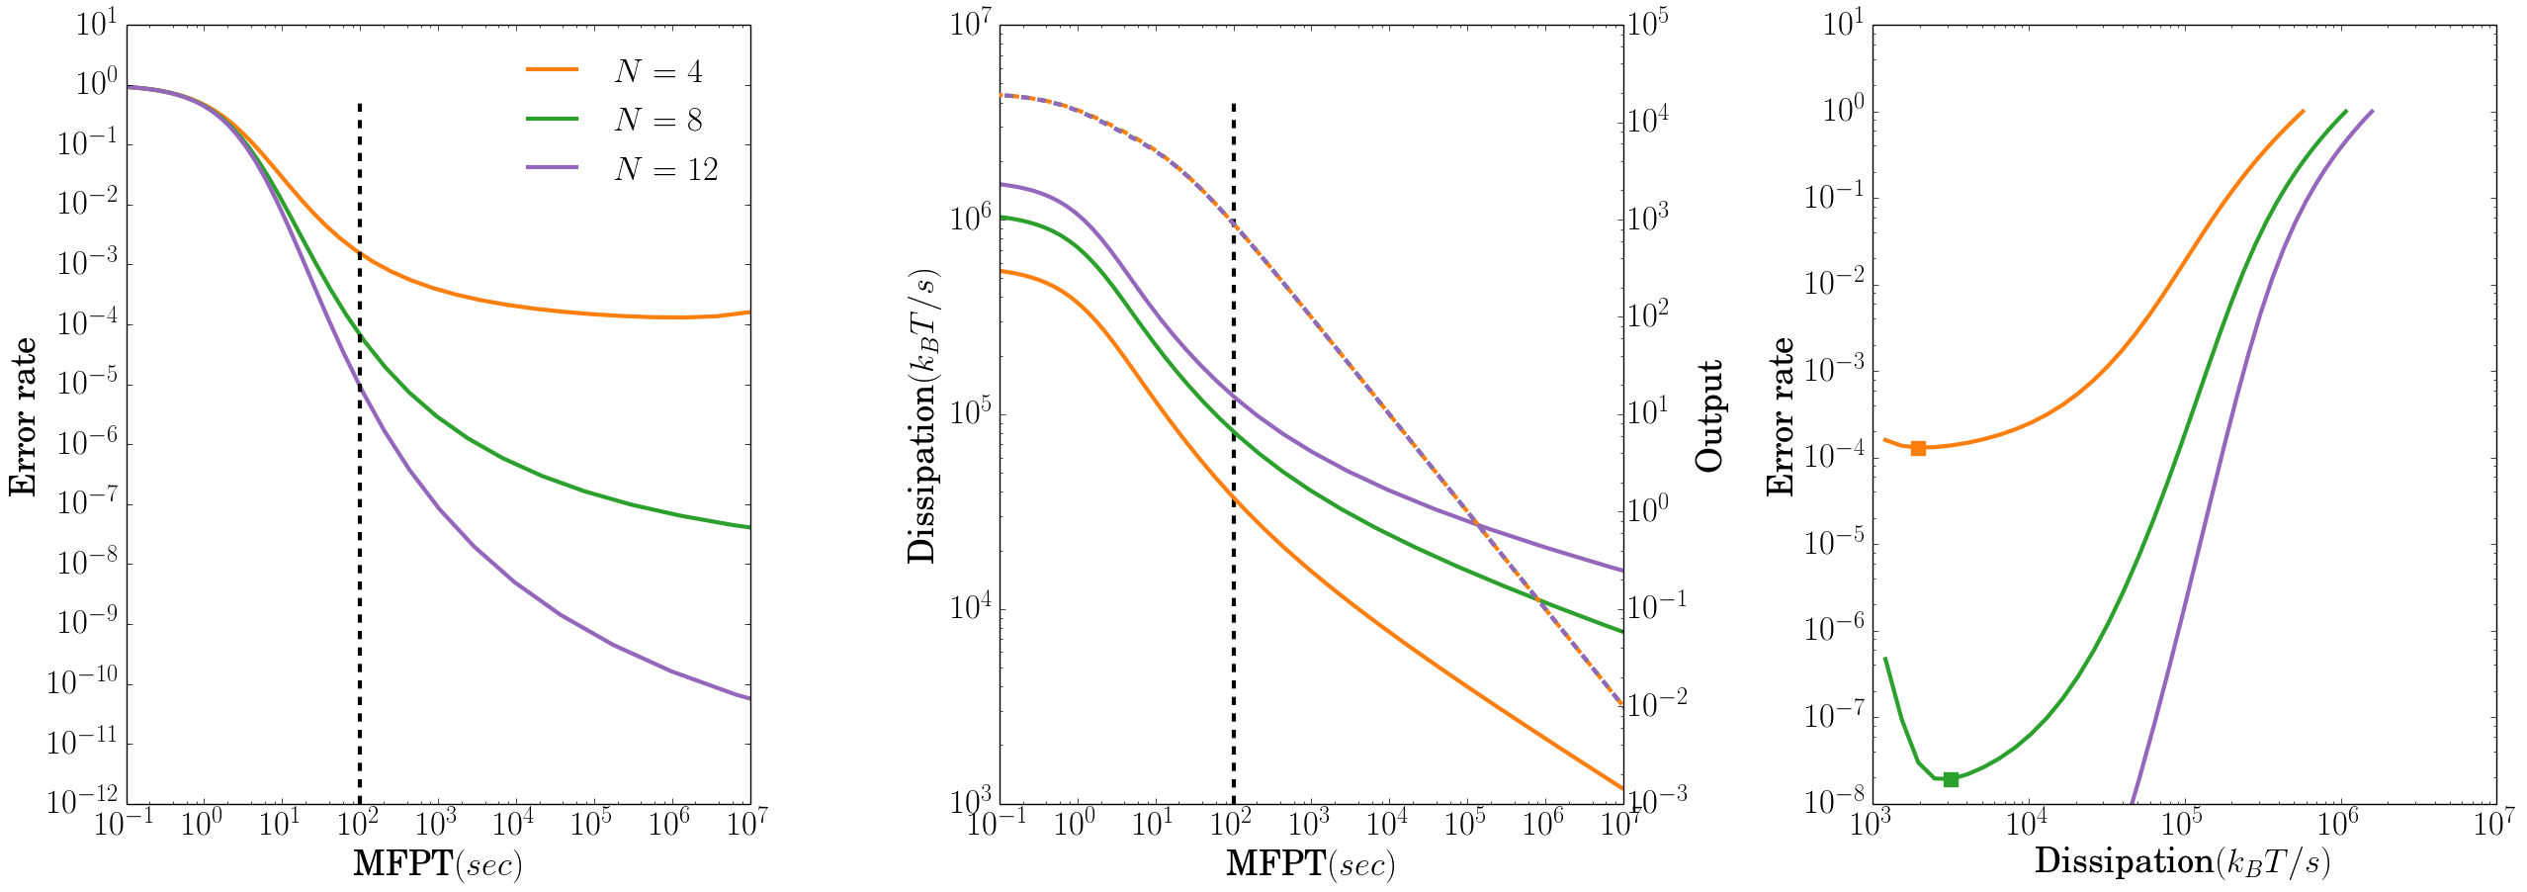
43
a.
b.

Slide 44
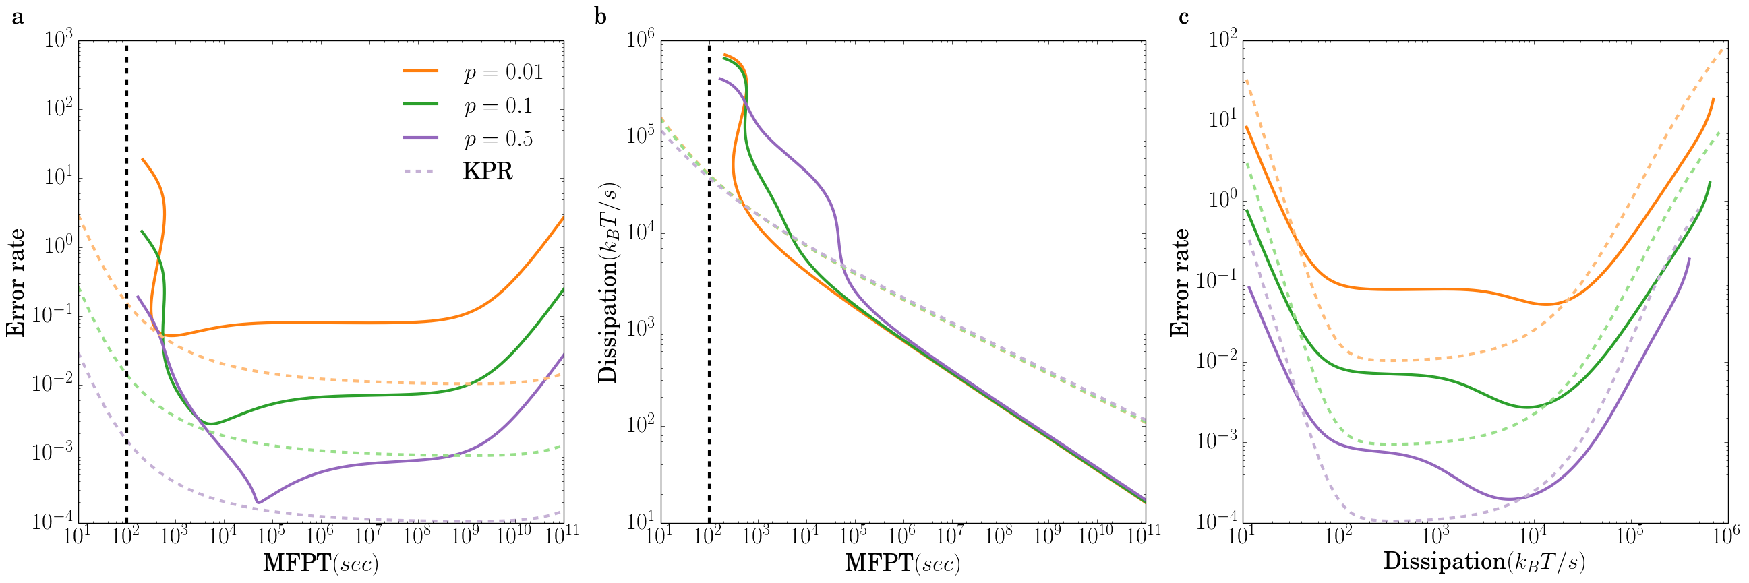
44

Slide 45
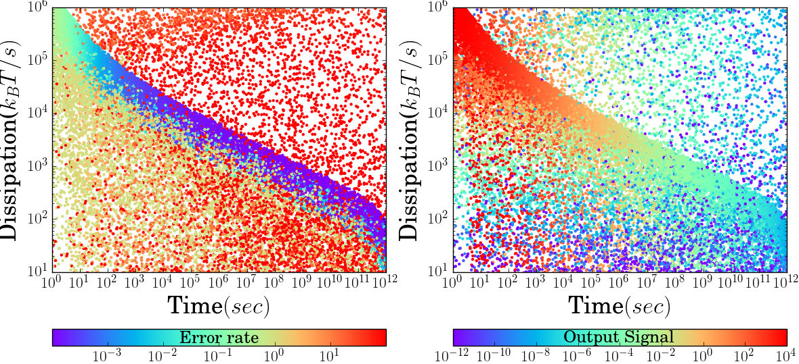
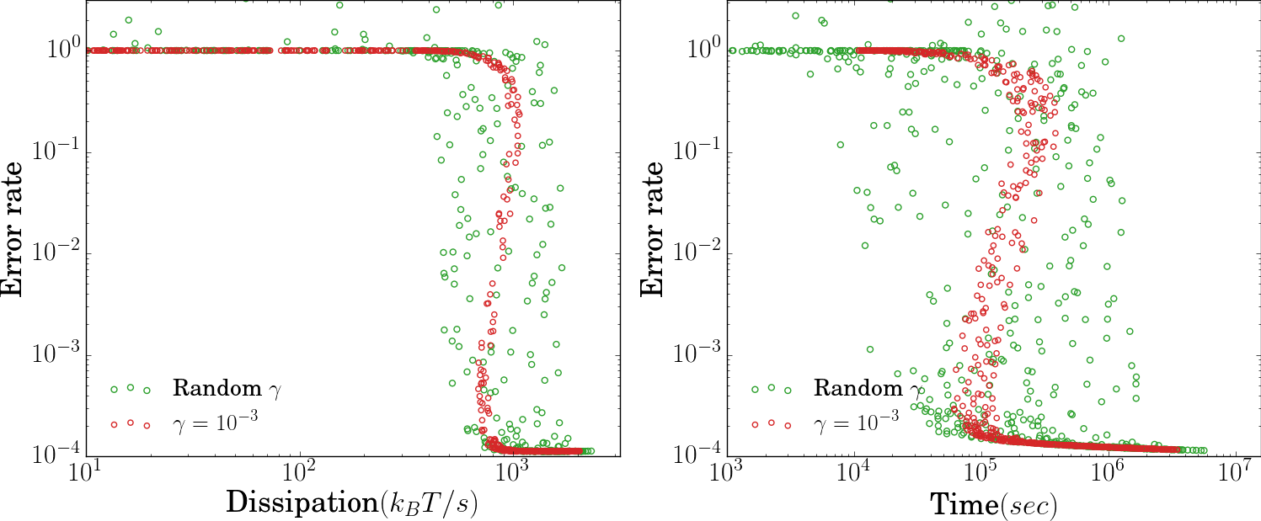
45
a.
b.
Optimal Point
A
C
B
D
B
c.
d.

Slide 46
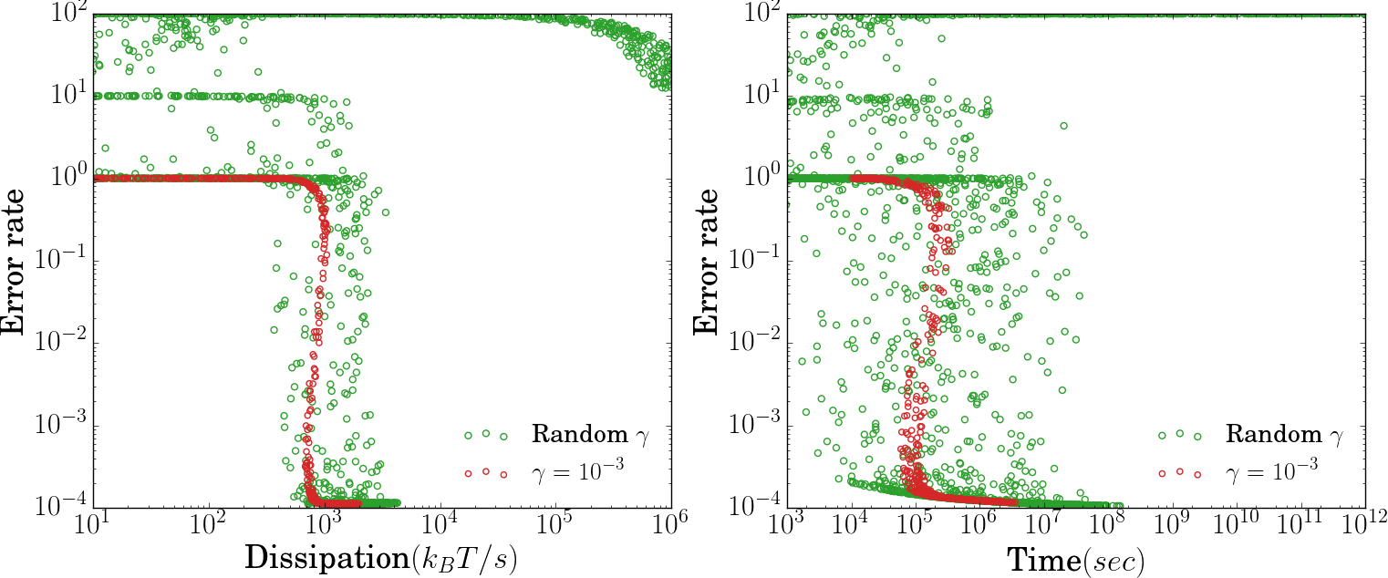
46
a.
b.
Optimal Point
A
C
B
D
B
c.
d.

Slide 47
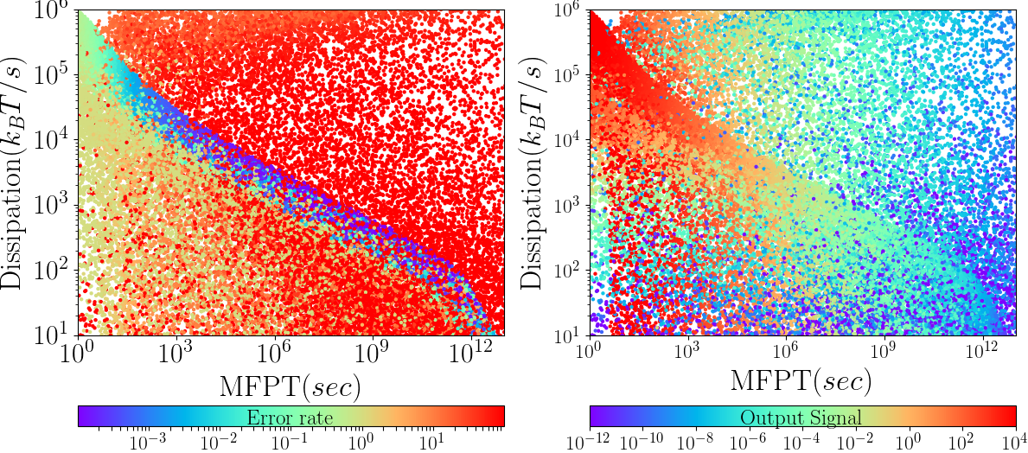
47
a.
b.
Optimal Point
A
C
B
D
B
c.
d.

Slide 48


Slide 49

49
a.
b.
Optimal Point
A
C
B
D
B
c.
d.

Slide 50
50

